Slide 1

Housing Subcommitte
Rental application violations update June 23, 2020

Slide 2
Rental Application Violations
46 Rental/Property Management Firms located in Colorado covering 1,043 properties
There was a lot of variability in number of properties impacted
Mean = 22.67, stdev = 45.84; median = 7.5
Type of Violation
The most common violation was to ask about criminal history without regard to the law (38-12-904(1)(b))
The next most common violation was to ask about rental history beyond the period specified in (38-12-904(1)(1))
More difficult to detect fee violations under 38-12-903

Slide 3
Some themes
Violations tended to co-occur
Multiple management firms rely on common apps like appfolio and rentcafe
Seem to be randomly distributed
Sometimes there was inconsistency in rental “guidelines” listed on website and what was in rental app
Some companies explicitly stated they abide by Colorado law while simultaneously violating it

Slide 4
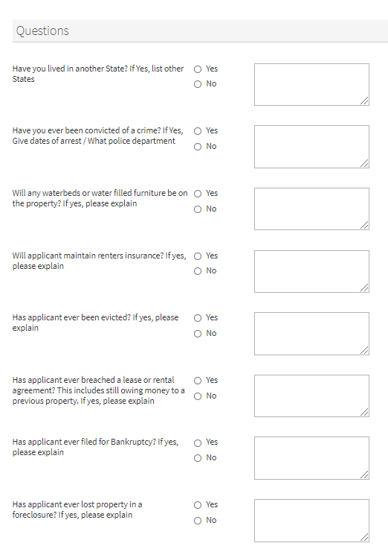
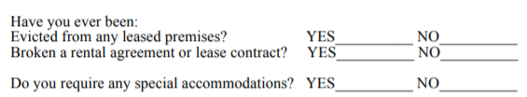
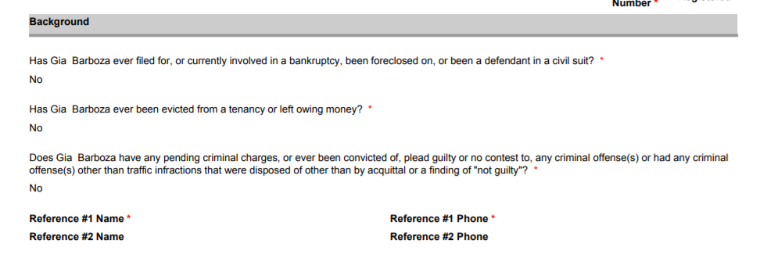
Example Violations

Slide 5
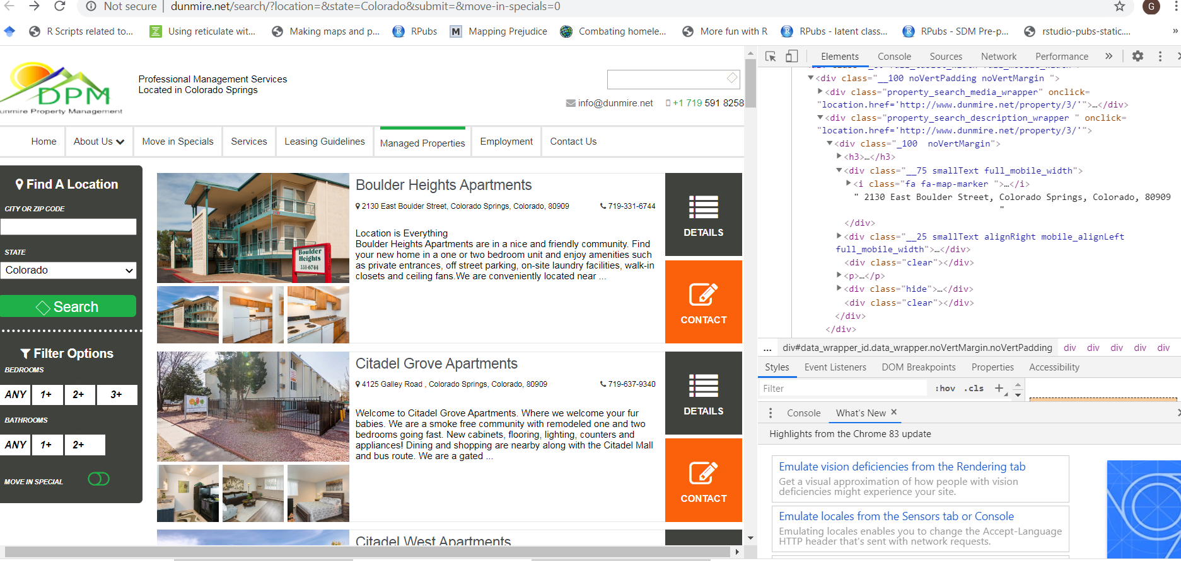

Slide 6
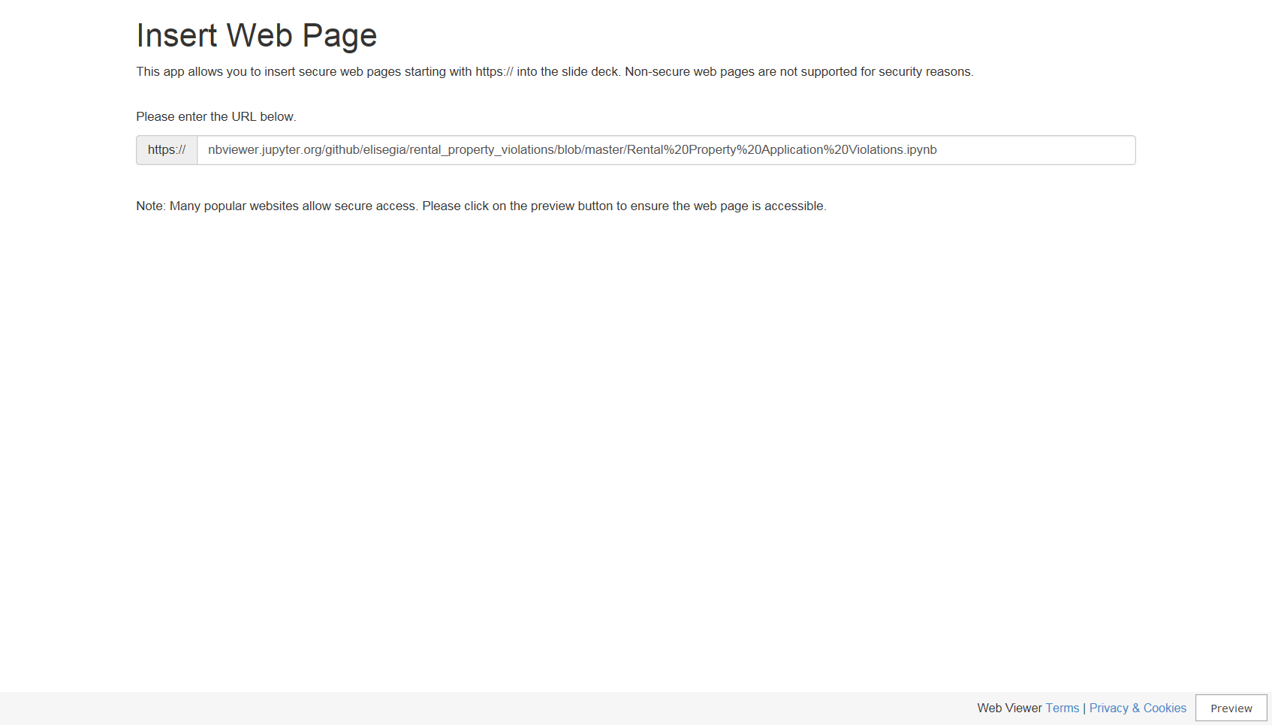

Slide 7
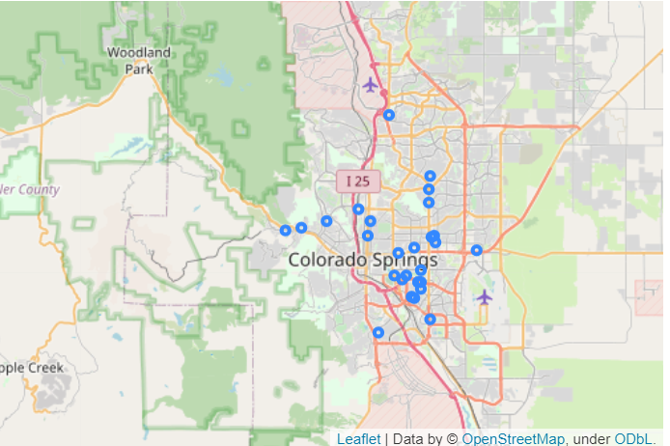
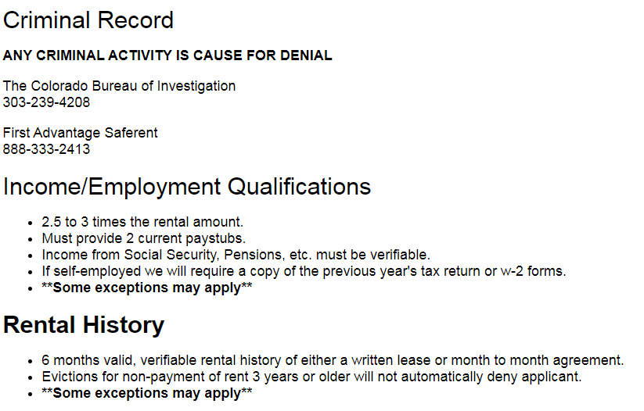
Listing of Rental Properties from Two Property Management Firms

Slide 8
Possible Report
Background
Demographic Profile
Income Profile
Employment Profile
Housing Profile
Environmental Profile

Slide 9
Demographic | Income | Employment | Housing | Neighborhood
Population trends Age and Sex Characteristics Race/Ethnicity Disability Type Racial Integration Dissimilarity Index; School Proficiency Index Housing and Household Projections | HH, Family and per capita income Poverty index RE/Caps Racial/Ethnic concentrated areas of poverty Special housing needs profiles Seniors Disabilities Homeless Children Disability Resource Providers | Jobs Proximity Index; Labor Market Engagement Index; Low Transportation Cost Index; Transit Trips Index; Major Employers Jobs held by residents | Rent Burden Available Housing Units For-sale and for-rent housing prices Housing supply Home ownership Housing condition Housing Problems Affordable housing Evictions Foreclosures Housing choice vouchers Public housing tracts Home loan application activity Housing Price Index Physical inspection scores Fair Housing Violations | Environmental Health Index Land use & Zoning Crime and Violence/Prison populations Social, housing, household and economic vulnerability Child Lead Poisoning Risk Food insecurity/deserts Environmental Justice Index
U.S. Census Bureau, American Housing Survey Co. Department of Local Affairs | Office of Housing & Urban Dev. Point in Time Homeless estimates Child opportunity index CO Dept. of Public Health | Denver Office of Economic Development Federal Reserve Econ. Data | Consumer Financial Protection Bureau, HMDA Database Office of Policy Dev. & Research Office of Housing & Urban Dev. Affirmatively Furthering Fair Housing Data Princeton Eviction Lab | Denver Police Department, Data Analysis Unit City and County of Denver - Excise and Licenses CO Dept. of Public Health Environmental Protection Agency
https://github.com/elisegia/Colorado-Housing

Slide 10
Household Type
Table 1. Households By Household Type in Denver, CO
 |  | Year: 2018
 |  | Number | %
Family HH |  | 143,098 | 48.6%
Married Couple |  | 101,314 | 70.8%
Married w/children |  | 44,892 | 44.3%
Married w/out children |  | 56,422 | 55.7%
Other families |  | 41,784 | 29.2%
Non-family HH |  | 151,260 | 51.4%
Total |  | 294,358 | 100%
Ave. HH size |  | 3.19

Slide 11
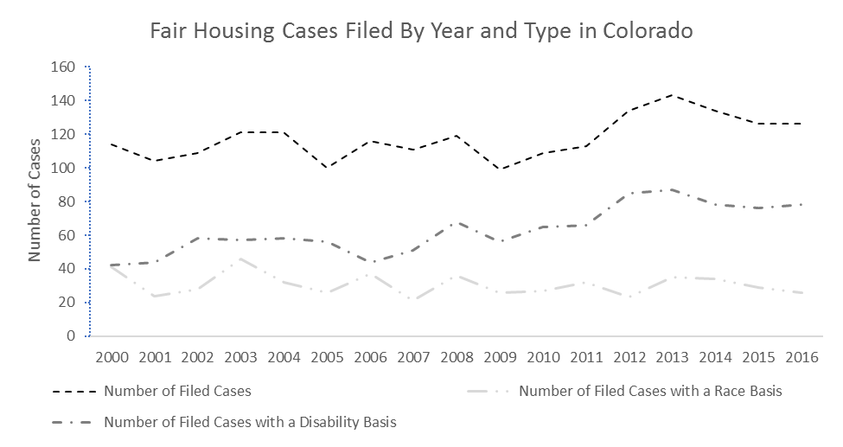
U.S. Department of Housing and Urban Development
Little change in the number of claims filed between 2000 – 2016 in the state of Colorado
The overall trend in the number of cases masks differences in temporal trends by claim type
the number of cases based on disability states increased
the number of claims filed based on race decreased, between 2000 – 2016.

Slide 12
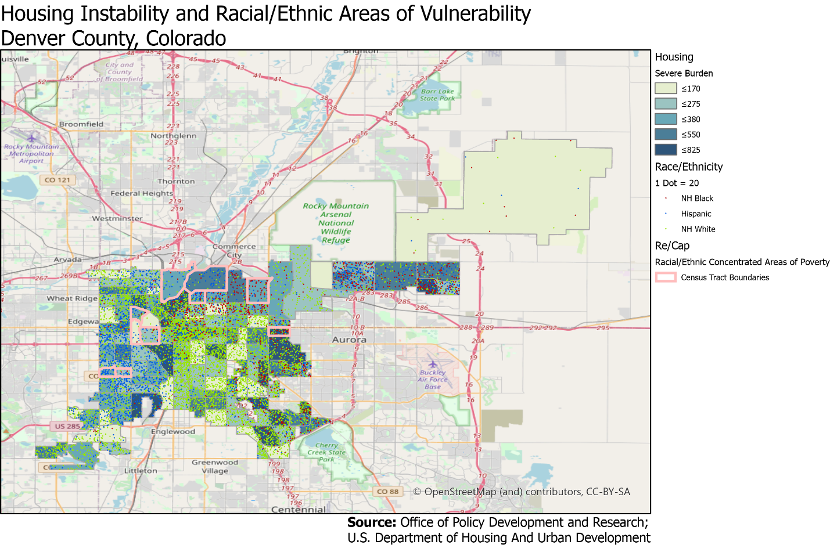
Office of Policy Development and Research
in Denver County, census tracts with high numbers of severely burdened households are highly correlated with census tracts characterized as communities of color and/or those designated as racial/ethnic concentrations of poverty.

Slide 13
U.S. Census Bureau, American Housing Survey
How Respondent Found Current Unit
Word of mouth | 92.3 | 23.7 | 68.6
Newspaper or other publication | 8.3 | -- | 6.6
Internet site (Craig’s List, Zillow, realtor.com, apartment. Com) | 154.7 | 37.8 | 117.0
Apartment rental agency listing | 17.1 |  | 16.2
Talking with a real estate agent | 73.8 | 66.7 | 7.0
Sign on outside of building/house | 40.6 | 9.1 | 31.4
Other | 42.6 | 12.0 | 30.6
Not reported | 14.3 | 5.8 | 8.5

